Slide 1

PROCTORING ANOMALY DETECTION IN ONLINE EXAM
SUBMITTED BY VARUN V (231801185)
VIGNESH R (231801508)
MOHAMED HARRIS (231801503)

Slide 2
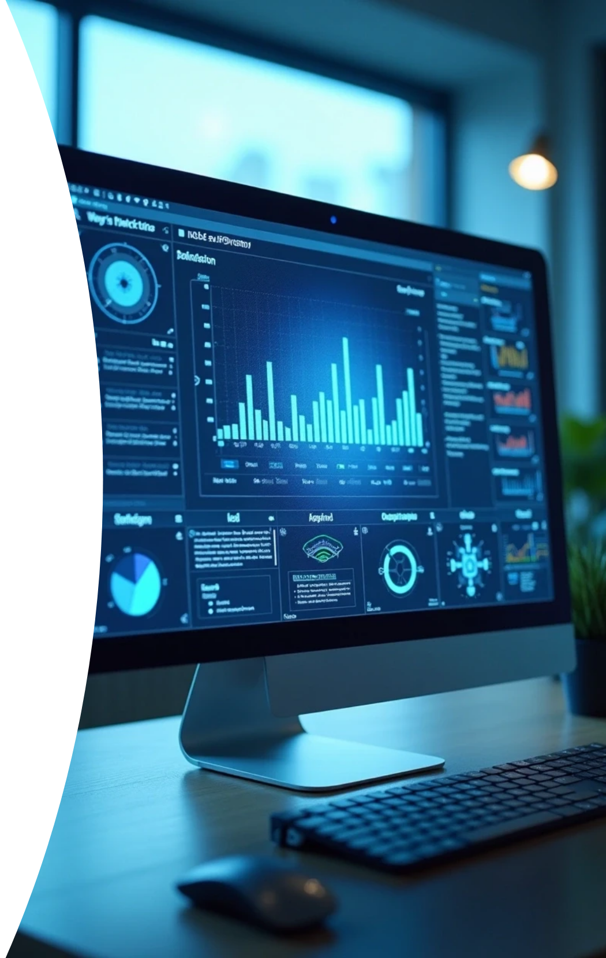
Proctoring Anomaly Detection
This presentation delves into the critical area of anomaly detection in online proctoring systems. It highlights the need for robust monitoring and data analysis within a big data architecture to preserve the integrity of examinations. By effectively identifying and responding to irregular behaviors, we aim to enhance the overall security and credibility of the assessment processes.

Slide 3
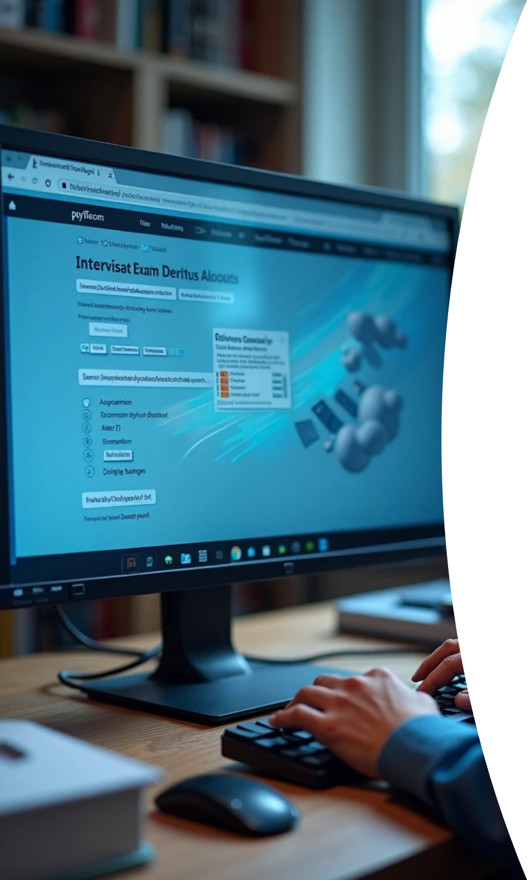



Introduction to Proctoring
1
Definition of Proctoring
Proctoring involves supervising online examinations to prevent cheating and ensure academic integrity.
2
Importance of Anomaly Detection
By identifying unusual patterns during exams, proctoring systems can flag potential cheating incidents.
3
Role of Big Data
The integration of big data technologies allows for effective analysis of data generated during online exams.

Slide 4



Big Data Architecture Overview
Components of Architecture
2
Includes data ingestion layers, storage solutions, processing engines, and visualization tools.
Foundation of Big Data
Frameworks and tools supporting large dataset management.
1
3
Benefits for Proctoring
Enhances speed and accuracy of anomaly detection in real-time.

Slide 5







Anomaly Detection Techniques
1
Statistical Methods
Statistical models identify deviations from expected behavior patterns.
2
Machine Learning Approaches
Machine learning algorithms enhance detection by learning data trends automatically.
3
Real-Time Monitoring
Real-time analysis enables immediate response to suspicious behaviors.

Slide 6


Case Studies and Applications
Successful Implementations
Comparison of Methods
Recommendations for Institutions
Analyzing different approaches to proctoring reveals varying degrees of success, with machine learning techniques often outperforming traditional methods.
Institutions using anomaly detection in their proctoring systems have reported reduced cheating rates and heightened exam security.
Schools should consider investing in scalable anomaly detection systems that prioritize data privacy and integrity.

Slide 7



Challenges and Considerations
False Positives and Negatives
Maintaining a balance between sensitivity and specificity in detection algorithms is critical; high false positive rates can undermine trust in proctoring systems.
Data Privacy Issues
Technological Limitations
The collection and analysis of student data raise concerns around privacy and consent, necessitating the implementation of robust data governance policies.
As technology evolves, keeping systems up-to-date with the latest advancements is essential for maintaining effectiveness and addressing emerging cheating methods.
2
1
3

Slide 8





Future Directions for Proctoring Systems
1
2
3
Enhanced Algorithms
Integration with Emerging Technologies
User Education
Research into evolving algorithms and techniques, particularly in the field of artificial intelligence, holds great potential for more accurate anomaly detection.
Institutions should focus on educating students about proctoring systems and the importance of academic integrity to foster a culture of honesty and reduce the need for excessive monitoring.
Exploring the synergy between proctoring systems and advanced technologies, such as blockchain for secure data management, could redefine online assessments.

Slide 9




Enhancing Academic Integrity in Online Exams
Anomaly detection in online exams is a vital component of maintaining academic integrity in the digital age. By leveraging big data architecture, institutions can implement more effective proctoring solutions that adapt to changing technological landscapes and ensure fair assessment environments. The future of online examinations depends on innovative approaches and a commitment to upholding ethical standards in education.
1
2
3
Importance of Anomaly Detection
Utilizing Big Data Architecture
Future of Online Assessments

